Slide 1

LEADERSHIP SKILLS

Slide 2

WELCOME
Let’s know more about each other
Your Name
Job Role
Years of Experience in Automotive
What are your expectations from this training
Notes:
Start with introducing yourself and then ask each participant to introduce him/herself.

Slide 3
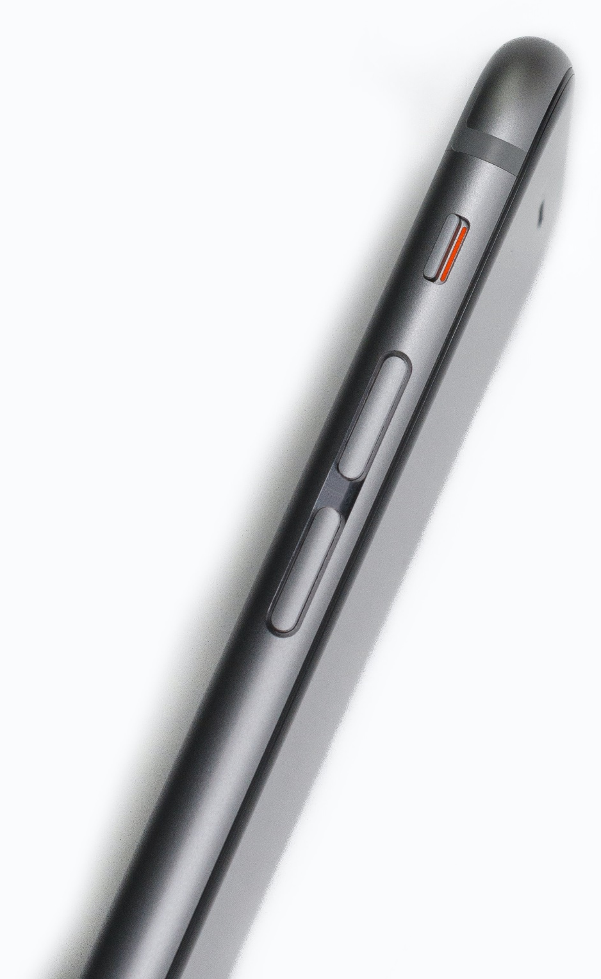
SESSION RULES
PHONE ON SILENT MODE
LUNCH WILL BE READY AT ……
Notes:
Go through the housekeeping rules and the break times

Slide 4
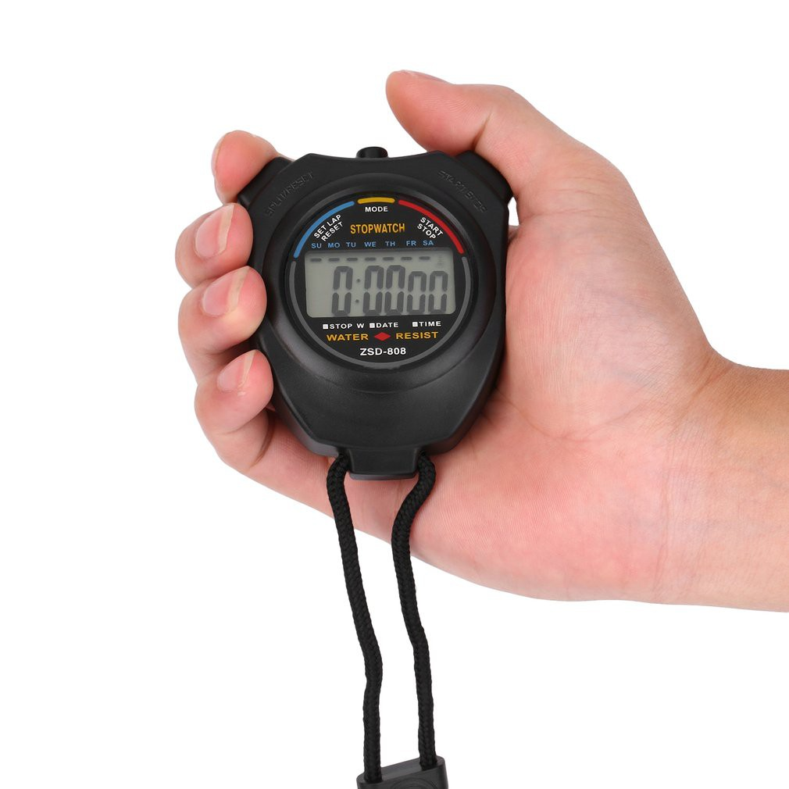
SESSION RULES
BE BACK ON TIME
COFFEE BREAKS ARE ALWAYS 15 MINS
Notes:
Go through the housekeeping rules and the break times

Slide 5
OBJECTIVES
By the end of this course, Managers will be able to:
1
Understand leadership and its role in managerial positions
2
Know how to build a team and drive that team to success
3
How to coach, mentor, develop & manage different employees
4
Understand the principles of Problem Solving & Conflict Resolution
5
How to transform from a Boss to a Leader
Notes:
SAY: The objectives of this course are as follows
Read the objectives
SAY: This course is designed to work as a part of the overall management courses that some of you have attended

Slide 6
AGENDA
1
Introduction
2
Leadership & its role
3
Building a success driven team
4
Coaching & mentoring different employees
5
Problem solving & conflict resolution
6
Boss to leader
Notes:
SAY: We will break the course into the following agenda

Slide 7
MODULE ONE
LEADERSHIP & IT’S ROLE

Slide 8
LEADERSHIP
Definition
01
Leadership styles
02
Change Leadership
03
Theories of Leadership
04
Notes:
Leadership & its role
SAY:
We will examine 4 areas of leadership in this module,
We will define it.
We will look at different styles of leadership
We will look at how leadership has changed in recent times
Finally we will examine the role of a leader

Slide 9
ACTIVITY 1 LEADERSHIP
In this activity, we will define what exactly we mean when we are talking about ‘Leadership”.
Notes:
SAY:
OK everyone let's spend a few minutes and I want you to come up with a list of what a leader is, what their role is, and how a leader is different from a Manager

Slide 10

LEADERSHIP : DEFINITION
The definition of a leader
“A person who leads a group, organization or country”
“A manager tells his team what to do. A leader tells his team what to do as well…… but makes them want to do it”
Notes:
Leadership & its role
SAY: Here is a very simple definition of a leader
And a distinction between a manager and a leader

Slide 11
LEADERSHIP : DEFINITION
A group of workers and their leaders are set on a task of clearing a road through a dense jungle on a remote island to get to the coast where an estuary provides a perfect site for a port
The leaders organise the labour into efficient units and monitor the distribution and use of capital assets – progress is excellent. The leaders continue to monitor and evaluate progress, adjusting along the way to ensure the progress is maintained and efficiency increased wherever possible
Then, one day amidst all the hustle and bustle and activity, one person climbs up a nearby tree. The person surveys the scene from the top of the tree
He shouts down to the well-organized efficient teams. “Wrong Way”
Management is doing things right, Leadership is doing the right things
Notes:
SAY:
Here is a short story to show you the difference between Management & Leadership

Slide 12

LEADERSHIP : STYLES
There are many different styles of leadership. We will be focusing on 4 of the main ones.
Autocratic
Democratic
Laissez Faire
Paternalistic
Notes:
Leadership & its role
SAY: We will be looking at 4 of the most common types of leadership.
Its important to realize that they are not good and bad, and great leaders can switch between them as appropriate

Slide 13
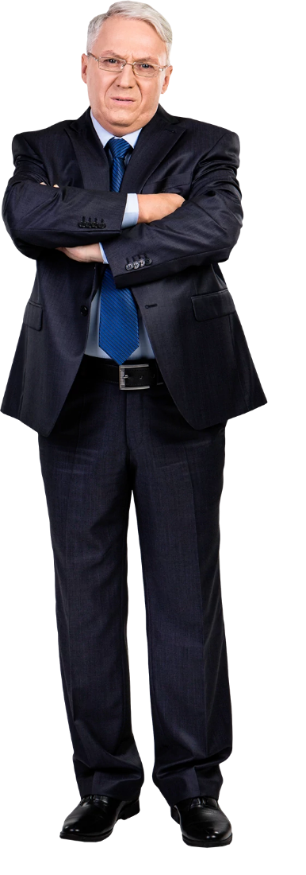
LEADERSHIP : STYLES
1
Autocratic
Leader makes decisions without reference to anyone else.
High degree of dependency on the leader.
Can create de-motivation and alienation of staff.
May be valuable in some types of business where decisions need to be made quickly and decisively.
Notes:
Autocratic: Sometimes we are forced to adopt this type of leadership. It is one where it can be exhausting if it is the only method you use.

Slide 14
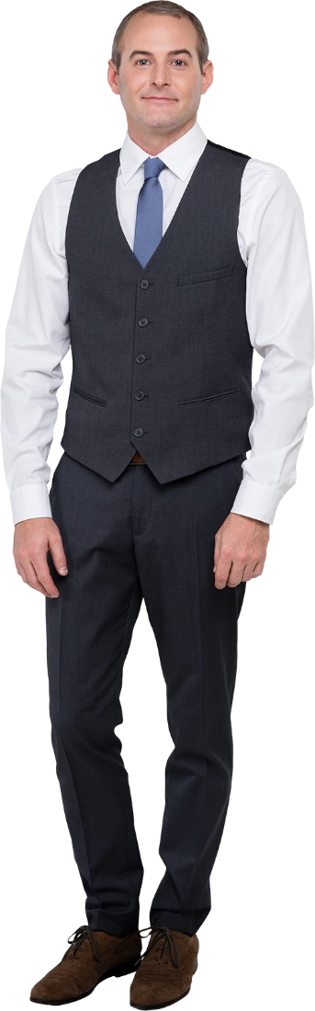
LEADERSHIP : STYLES
2
Democratic
Encourages decision making from different individual perspectives.
Can help with motivation & involvement of the team.
Improves the sharing of ideas and experience within the business.
Can sometimes make the manager seem indecisive.
Can slow down the decision making process.
Notes:
SAY: Can make you a popular boss, but maybe not a good one. Especially if you rely on this leadership style exclusively

Slide 15
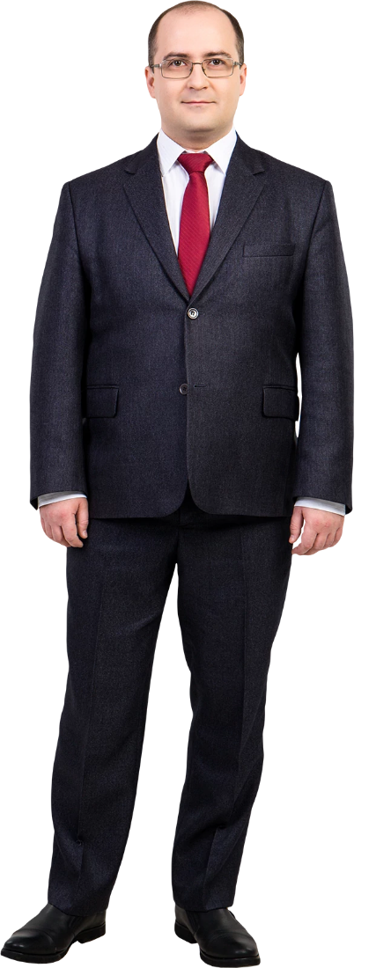
LEADERSHIP : STYLES
3
Laissez Faire ( Free Reign)
‘Let it be” – Leadership responsibility is shared by all.
Can be useful in businesses where creative ideas are important.
Motivation is high because people have control over their working lives.
Can be time consuming and can result in a lack of overall direction.
Relies on good team work and good team skills.
Needs to have good interpersonal relations between all team members.
Notes:
SAY: This form of leadership will only work effectively with mature, highly skilled teams

Slide 16

LEADERSHIP : STYLES
4
Paternalistic
Leader acts as a “parent figure.”
Paternalistic leaders will make most of the decisions but may consult occasionally.
Believe in the team being in a supportive role.
Team members are treated as the children in this relationship.
Notes:
SAY: This works well with young immature teams but will eventually become patronizing

Slide 17

LEADERSHIP : STYLES
Which is best?
Type of staff
History of the business
Culture of the business
Quality of the relationships
Nature of the changes needed
Accepted norms within the institution
Notes:
SAY: Ok which of these styles do you think is the best
Like most things in life it depends on the circumstances You will need to switch between them if you expect to become an excellent leader

Slide 18

ACTIVITY 2 FACTORS EFFECTING STYLE
Great leaders can change their style depending on circumstances.
List some situations that could need a change in leadership style
Notes:
SAY:
OK everyone let's spend a few minutes and I want you to come up some circumstances where you would need to change your style of leadership.

Slide 19
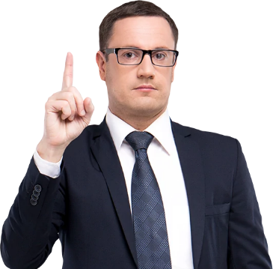
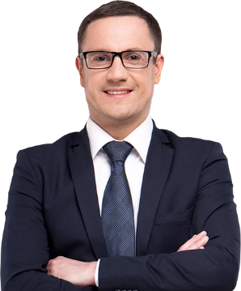
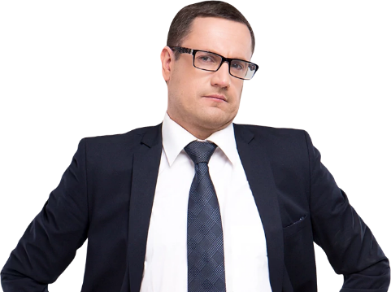
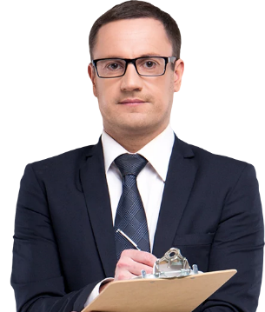
LEADERSHIP : FACTORS EFFECTING STYLE
What factors can affect leadership style?
Risk: Change initiatives & decision making situations.
Type of business: Creative or supply driven.
Importance of change: Change for change sake. Major business change.
Organisational culture: May be a long embedded situation
Nature of the task: need cooperation , direction & structure
Notes:
SAY: Leadership styles can be dependent on many circumstances

Slide 20
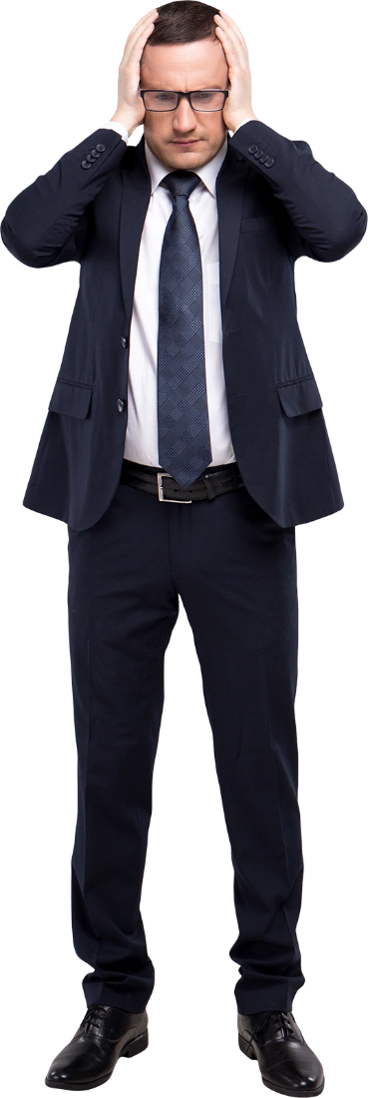
LEADERSHIP : CHANGE LEADERSHIP
One of the hardest tasks is to lead during change
The business environment is subject to fast-paced economic and social change.
Modern business must adapt and be flexible to survive.
The most challenging aspect of business is leading and managing change.
Problems in leading change stem mainly from human resource management.
Leaders need to be aware of how change impacts workers.
Notes:
SAY: Leading a team through change can be a daunting task for the most experience leaders
SAY: Covid 19 has led to some profound changes in how our industry does business

Slide 21
LEADERSHIP : CHANGE LEADERSHIP
Kubler Ross Change Curve
07
Shock: Surprise or shock at the event.
Denial: Disbelief Look for evidence that it isn’t true or it won’t effect you.
Frustration: Recognition that things are different.
Depression: Low mood, poor performance, lacking in energy.
Experimentation: Initial engagement with the new situation.
Decision: Learning how to work in the new situation, feeling more positive.
Integration: Changes integrated resulting in a renewed individual.
02
01
06
Moral
03
05
04
Time
Notes:
SAY: In order to manage change we must understand the process that individuals go through when faced with change
1. Shock – as rumours of the change circulate, the individual feels some sense of shock and possible disbelief – so much so that they deem it worthy of doing nothing.
2. Denial: As the change becomes clearer, people try to fit in the change with their own personal position and may try to believe that it will not affect them.
3. Frustration: Can sometimes manifest as anger at the situation and the fear of the unknown.
4. Depression: as reality begins to dawn staff may feel alienated and angry, feelings of a lack of control of events overtake people and they feel depressed as they try to reconcile what is happening with their own personal situation.
5. Experimentation: Individuals begin to interact with the change, they start to ask questions to see how they might work with the change.
6. Decision: Individuals begin to work with the change and see how they might be able to make the change work for them – self esteem begins to rise.
7. Integration: the change is understood and adopted within the individual’s own understanding – they now know how to work with it and feel a renewed sense of confidence and self esteem.

Slide 22
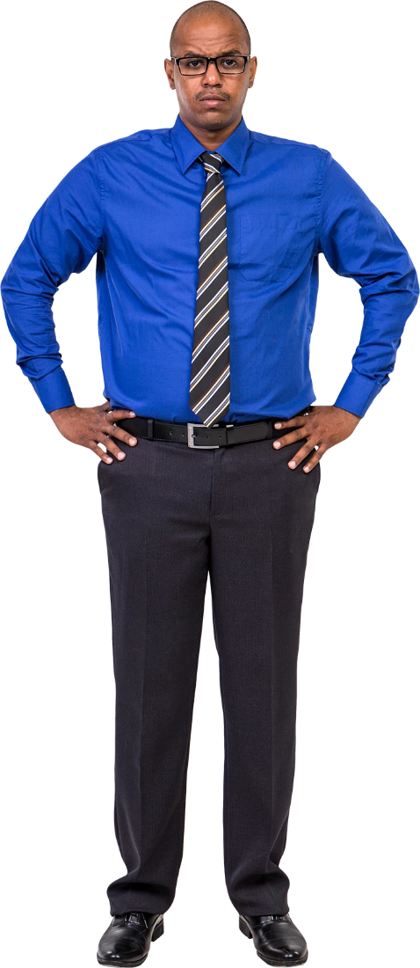
LEADERSHIP : THEORIES OF LEADERSHIP
Is there a set of characteristics that determine a good leader?
Personality.
Dominance and personal presence.
Charisma.
Self confidence.
Achievement.
Ability to formulate a clear vision.
Notes:
Leadership & its role
Trait theories:
Are such characteristics inherently gender biased?
Do such characteristics produce good leaders?
Is leadership more than just bringing about change?
Does this imply that leaders are born not bred?

Slide 23
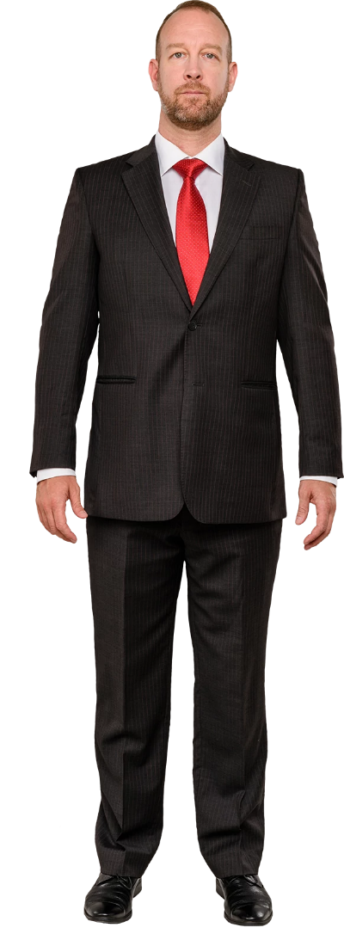
LEADERSHIP : THEORIES OF LEADERSHIP
Behavioral Leadership
Imply that leaders can be trained.
Focus on the way of doing things.
Structure based: Focus on instituting structures – task orientated.
Relation based: Focus on developing relationships – process orientated.
Notes:
SAY: You behavior can set the entire tome of your leadership
It is particularly strong when it comes to cultivating a successful driven team

Slide 24
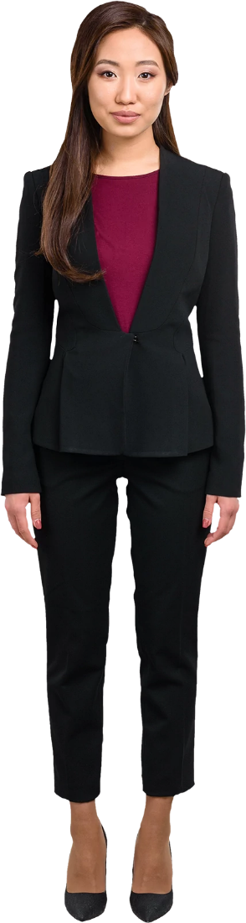
LEADERSHIP : THEORIES OF LEADERSHIP
Contingency Leadership
Greater degree of flexibility.
Different styles for different situations.
Suggests leadership is not a fixed set of characteristics.
Leadership characteristics can be transposed into different context.
Notes:
Change as the circumstances dictate

Slide 25
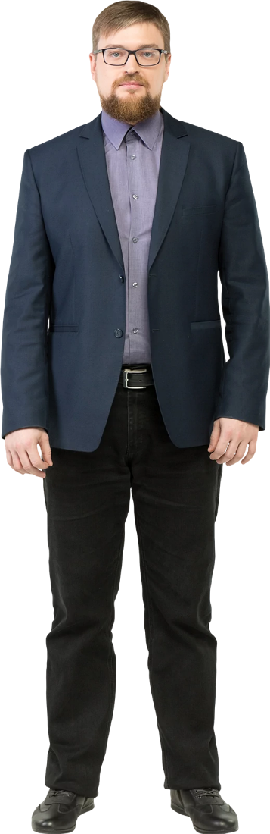
LEADERSHIP : THEORIES OF LEADERSHIP
Transformational Leadership
Needed when there are widespread changes to a business.
Long term strategic planning.
Development of clear objectives.
Clear vision of the path needed to achieve the desired changes.
Leading by example.
Maximise efficiencies of system and process.
Notes:
SAY Transformational leadership is a great asset when a company is going through changes
Refer to Apple Story

Slide 26
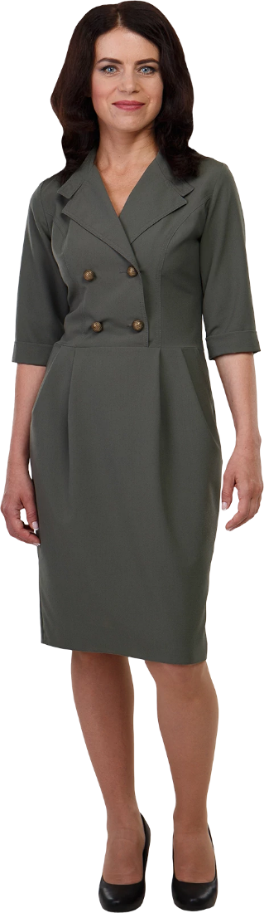
LEADERSHIP : THEORIES OF LEADERSHIP
Transactional Leadership
Focus on the management of the business.
Procedures and efficiencies are the main priorities.
Working to a set of rules and contracts.
Managing the current issues and problems.
Notes:
This is how management has been seen in the past and is great when you need to have a team follow set procedures and the team is constrained by very specific instructions, legal reasons for example

Slide 27
MODULE TWO
TEAM BUILDING

Slide 28
TEAM BUILDING
Team development
01
Team norms
02
TORI model
03
Success driven
04
Notes:
Module 2 Team Building
SAY: WE will look at how teams develop what are the perceived normal for a team

Slide 29
ACTIVITY 2 TEAM BUILDING
What are the five stages of team building?
Let’s look at them
Notes:
SAY:
OK, does anyone know the 5 stages of team building

Slide 30





TEAM BUILDING
FORMING
The early stages of a new team, could also be the addition of new members to an existing team.
STORMING
Time of conflict where people are trying to establish themselves within the team.
NORMING
A time of settled performance. Major conflicts have been resolved and the team is started to gel.
PERFORMING
Team has matured to the point that they can perform in a functional effective manner.
ADJOURNING
Project is finished and the team disbands.

Slide 31
TEAM BUILDING
1
Forming
The forming stage involves a period of orientation and getting acquainted.
Uncertainty is high during this stage, and people are looking for leadership and authority.
A member who asserts authority or is knowledgeable may be looked to take control.
Team members are asking such questions as “What does the team offer me?” “What is expected of me?” “Will I fit in?”
Most interactions are social as members get to know each other
Notes:
SAY: This is the first stage of any new team, but can also apply when there are a fairly large number of changes in team personnel

Slide 32
TEAM BUILDING
2
Storming
This stage is a period marked by conflict and competition.
Team performance may decrease because energy is wasted in unproductivity.
Members will disagree and subgroups and cliques will form.
To overcome this stage members must work together to overcome obstacles and accept individual differences.
Failure to address the conflict at this stage may lead to long-term problems.
Notes:
SAY: this is a time of great delicacy within a team, it could actually break the team
If you have a team with a high turnover you will just keep repeating Forming & Storming with out moving forward developing your team

Slide 33
TEAM BUILDING
3
Norming
Once through the storming stage, conflict is resolved, and unity starts to emerge.
Individual roles and leadership status will be established.
Interpersonal differences are resolved, and a sense of cohesion and unity is formed.
Team performance will increase during this stage. Problems and conflict will still occur and can cause a slip back into the storming stage.
Notes:
SAY: Norming is when you have a functional team. Most of the conflict will have been resolved at this stage and you can begin to really develop your team into a great one.

Slide 34
TEAM BUILDING
4
Performing
Consensus and cooperation has been well established.
Team is mature, organized and well functioning.
There is a clear structure and members are committed to the team goals.
Team performance will increase during this stage. Problems and conflict will still occur, but they are dealt with constructively.
The team is focused on problem solving and meeting team goals.
Notes:
With the right leadership you can take your team and transform them into high successful, well motivated team.

Slide 35
TEAM BUILDING
5
Adjourning
Once a team's goals have been achieved the emphasis is on completed final tasks and documenting the results.
Long term teams very rarely enter this stage. They have a never-ending list of tasks to complete.
The entry of new members to the team may well mean a repeating of the Forming or Storming stages.
Notes:
Highly motivated, successful teams often do not even enter this stage

Slide 36
ACTIVITY 3 TEAM NORMS
All teams have norms: rules & guidelines
These are often unwritten.
What are some of the norms within your team?
Notes:
SAY:
Let’s look at some of the unwritten rules that may teams work around.

Slide 37
LEADERSHIP : TEAM NORMS
All teams have norms, these are rules and guidelines that ensure the behaviors of all team members align.
In most cases they are not written down.
Norms can be a positive, ensuring the team has a code of conduct that everyone understands.
In some instances they can be seen as counterproductive. Especially when one norm suits some team members and not others.
Some teams spend time and establish a set of norms.
Notes:
Leadership & its role
SAY: These rules may be unwritten but they are extremely important

Slide 38
LEADERSHIP : TORI
Has anyone heard of the TORI team building model and, more importantly, has anyone ever used it to build a team?
TRUST.
OPENNESS.
REALIZATION.
INTERDEPENDENCE.
Notes:
Leadership & its role
The TORI Modle for successful teams

Slide 39
LEADERSHIP : TORI
As teams develop and move from a low performing, new team to a mature high performing team the dynamics within the team changes.
From defensive and formal relationships to freer, trusting ones.
From distorted and closed communication to openness and candor.
Competitive problem solving and goal achievement become the norm .
The team starts to rely on each other, which leads to greater success.
Notes:
Leadership & its role
As leaders it is our job to cultivate these changes

Slide 40
MODULE THREE
SUCCESS DRIVEN

Slide 41
LEADERSHIP : SUCCESS DRIVEN
True leaders are personally driven to be successful. Great leaders drive their teams to success as well. They achieve this through action.
TASK
Achieving the TASK.
Managing the TEAM
Managing INDIVIDUALS
TEAM
INDIVIDUAL
Notes:
Leadership & its role
SAY: As a leader your have three areas that you must focus on simultaneously

Slide 42
ACTIVITY 4 DRIVERS FOR SUCCESS
What are some of the key drivers that you can apply to ensure success?
Notes:
SAY:
OK, What can you do in order to make sure your team is success driven

Slide 43
LEADERSHIP : SUCCESS DRIVEN
SELF DIRECTION
Without the ability to know our own direction, how will we know the direction to lead our team.
PEOPLE SKILLS
People are individuals with individual styles and traits. Great leaders change their style to accommodate.
PROCESS SKILLS
Being able to prioritize and to handle complex multi-task situations is a must.
COMMUNICATION
All great leaders are fantastic communicators, no matter the situation they can ensure understanding.
ACCOUNTABILITY
Every member of a team needs to be accountable for their part of the task.
Notes:
ACTIVITY’S Answer
Self Direction What are your personal goals in the leadership position
Develop your people to get the best out of them
Make sure your processes are set to support your team
Communicate well so no one is every under any misunderstanding
Enures that all team members, including yourself, are fully aware of what there accountabilities are

Slide 44
LEADERSHIP : SUCCESS DRIVEN
SELF DIRECTION
Without the ability to know our own direction, how will we know the direction to lead our team.
Our experiences shape our beliefs and values.
These beliefs and values create our leadership style.
Our leadership style will form the environment in which our team will function.
Before we can set team goals, we must set our individual goals
Notes:
ACTIVITY’S QUESTIONS

Slide 45
LEADERSHIP : SUCCESS DRIVEN
PEOPLE SKILLS
People are individuals with individual styles and traits. Great leaders change their style to accommodate.
Greatest failure of new managers is the inability to form effective teams and partnerships.
Leaders build relationships with individuals.
Leaders build relationships through mutually trust and respect.
Leaders can change their leadership styles to meet the needs of the individual.
Notes:
ACTIVITY’S QUESTIONS

Slide 46
LEADERSHIP : SUCCESS DRIVEN
PROCESS SKILLS
Being able to prioritize and to handle complex multi-task situations is a must.
Put great people in a poor process and they may fail.
We cannot see a process. We can, however, see a poor performer. It is easy to blame a poor performer rather than the process.
Leaders must demonstrate the flexibility to plan, innovate, create clear objectives, delegate, analyze, decide and use time effectively.
Each day we should identify the synergy between our people and our processes and be prepared to adapt.
Leaders know that their people will support and sustain their visions and goals.
Notes:
ACTIVITY’S QUESTIONS

Slide 47
LEADERSHIP : SUCCESS DRIVEN
PROCESS SKILLS
Being able to prioritize and to handle complex multi-task situations is a must.
URGENT
NOT URGENT
Time is our most valuable possession.
Eisenhower's method of prioritization
IMPORTANT
NOT IMPORTANT
Notes:
SAY Eisenhower was a general in WW2 he had to make life and death decisions every day.
He developed this very simple, effective system to ensure that his time was spent where it was most needed
We will spend more time on this later in the course

Slide 48
LEADERSHIP : SUCCESS DRIVEN
COMMUNICATION
All great leaders are fantastic communicators, no matter the situation they can ensure understanding.
KISS: Keep It Simple, Stupid. Don’t over complicate things to try and impress.
Listen to understand, not to reply. Listen to everything that is being said to you before formulating your reply.
Speak clearly and enunciate your words. Best rate is approximately 150 words per minute.
Keep your volume at a comfortable level. Don’t be too loud or too quiet. Please should not have to strain to hear you.
Formulate your questions as a direct result of what is being said to you.
Notes:
ACTIVITY’S QUESTIONS

Slide 49
LEADERSHIP : SUCCESS DRIVEN
Every member of a team needs to be accountable for their part of the task.
ACCOUNTABILITY
All team members need to admit their mistakes, especially the leader. When you’re wrong, admit it. Lead by example.
Assist their teams to close the gap between expected performance and actual results.
Lead, coach, mentor, train your people to ensure the competition of goals and objectives.
Through the above your team should be able to create SMART objectives and goals.
Leaders provide direction and assistance to ensure these SMART goals are achieved.
Notes:
ACTIVITY’S QUESTIONS

Slide 50
LEADERSHIP : BUSINESS REALITIES
The very nature of modern business means that we must juggle several key factors.
Objectives, Time, Profit, all must be achieved in order for a team to be successful.
Your job, as a leader, is to find the balance point between all three.
Remember we are almost always short of time and resources.
OBJECTIVES
PROFIT
TIME
Notes:
Leadership & its role

Slide 51

MODULE FOUR
DIFFERENT EMPLOYEES

Slide 52

DIFFERENT EMPLOYEES
DISC model
01
Different personality traits
02
Relate with the different traits
03
Employee types
04
Notes:
Leadership & its role
SAY:
It is important that we understand what makes our people tick.
We will look at the 4 basic personality types, but before that we will identify our own personality type
We will then look at how we deal with them
Finally in this module we will look at employee types

Slide 53

DIFFERENT EMPLOYEES: DISC
DISC Model
The Disc profile is a, nonjudgmental, tool use to identify people’s behavioral differences.
If you participate in a DISC program, you will be asked to complete a series of questions that produce a detailed report about your personality and behavior.
Today you will patriciate in a “Mini” DISC program.
Notes:
We will use a MINI version of he DISC model for this exercise

Slide 54
ACTIVITY 5 DISC MODEL
In order to deal with different personalities we need to know how to identify them.
Let's start by identifying our own
Notes:
SAY:
OK, does anyone know the 5 stages of team building

Slide 55
DIFFERENT EMPLOYEES: DISC
STAGE 1:
I will show you 15 groups of words.
You must select the word that best describes you.
Just write down A B C or D.
Do not write down the word
Notes:
Leadership & its role
SAY: It is very simple
I will show you 15 groups of words. You must select the word that best describes you. Just write down ABC or D. Do not write down the word

Slide 56
Q1
Which of the following BEST describes you?
Daring جريء
Satisfied راضي
Enthusiasticمتحمس
Diplomatic دبلوماسي
Notes:
SAY: It is very simple
I will show you 15 groups of words. You must select the word that best describes you. Just write down ABC or D. Do not write down the word

Slide 57
Q2
Which of the following BEST describes you?
Decisive حاسم
Controlled متحكم به \ خاضع للسيطرة
Conventional تقليدي
Talkative كثير الكلام

Slide 58
Q3
Which of the following BEST describes you?
Moderate وسطي \ معتدل
Insightful يمتلك البصيرة
Adventurous مغامر
Outgoing ودي

Slide 59
Q4
Which of the following BEST describes you?
Insistent كثير الإلحاح
Magnetic جذاب
Agreeable مستعد للموافقة
Tactful لبق

Slide 60
Q5
Which of the following BEST describes you?
Strong willed قوي الإرادة
Cheerful مبهج
Obliging خدوم
Reserved متحفظ \ كتوم

Slide 61
Q6
Which of the following BEST describes you?
Stimulating محمس \ منشط
Independent مستقل
Perceptiveمدرك \ مميز
Kind طيب القلب

Slide 62
Q7
Which of the following BEST describes you?
Playful لعوب
Obedient مطيع
Fussy متطلب للعناية
Firm حازم

Slide 63
Q8
Which of the following BEST describes you?
Loyal متسم بالولاء
Charming ساحر
Bold جرئ
Logical منطقي

Slide 64
Q9
Which of the following BEST describes you?
Self-reliant إعتماد على الذات
Sociable إجتماعي
Patient صبور
Soft-spoken حلو اللسان \ متحدث بلطافة

Slide 65
Q10
Which of the following BEST describes you?
Animated مفعم بالحيوية
Self-disciplined منضبط
Patient صبور
Persistent مثابر \ مُصِر

Slide 66
Q11
Which of the following BEST describes you?
Forceful فعال \ نشيط
Introverted منطوي
Easy-going سهل التعامل معه
Impulsive مندفع \ تلقائي

Slide 67
Q12
Which of the following BEST describes you?
Refined مهذب \ لبق
Good mixer يختلط جيداً بالاّ خرين
Lenient متساهل
Vigorous نشيط \ مفعم بالحيوية

Slide 68
Q13
Which of the following BEST describes you?
Contented قانع \ راض
Demanding كثير المطالب
Captivating خلاب \ فاتن
Compliant مطيع \ مساير

Slide 69
Q14
Which of the following BEST describes you?
Systematic منظم \ متناسق
Argumentative يحب الجدل
Cooperative متعاون
Light-hearted أرعن \ خفيف الظل

Slide 70
Q15
Which of the following BEST describes you?
Even-tempered صعب الغضب
Direct صريح
Precise دقيق
Jovial مرح

Slide 71
DIFFERENT EMPLOYEES: DISC
STAGE 2:
You should now have 15 letters written down.
We now need to allocate a D, an I, an S or a C against your answers.
The allocation is random, so you don’t identify a pattern.
Notes:
Leadership & its role

Slide 72
Q1
Which of the following BEST describes you?
Daring جريء D
Satisfied راضي S
Enthusiasticمتحمس I
Diplomatic دبلوماسي C

Slide 73
Q2
Which of the following BEST describes you?
Decisive حاسم D
Controlled متحكم به \ خاضع للسيطرة S
Conventional تقليدي C
Talkative كثير الكلام I

Slide 74
Q3
Which of the following BEST describes you?
Moderate وسطي \ معتدل S
Insightful يمتلك البصيرة C
Adventurous مغامر D
Outgoing ودي I

Slide 75
Q4
Which of the following BEST describes you?
Insistent كثير الإلحاح D
Magnetic جذاب I
Agreeable مستعد للموافقة C
Tactful لبق S

Slide 76
Q5
Which of the following BEST describes you?
Strong willed قوي الإرادة D
Cheerful مبهج I
Obliging خدوم S
Reserved متحفظ \ كتوم C

Slide 77
Q6
Which of the following BEST describes you?
Stimulating محمس \ منشط I
Independent مستقل D
Perceptiveمدرك \ مميز C
Kind طيب القلب S

Slide 78
Q7
Which of the following BEST describes you?
Playful لعوب I
Obedient مطيع S
Fussy متطلب للعناية C
Firm حازم D

Slide 79
Q8
Which of the following BEST describes you?
Loyal متسم بالولاء S
Charming ساحر I
Bold جرئ D
Logical منطقي C

Slide 80
Q9
Which of the following BEST describes you?
Self-reliant إعتماد على الذات D
Sociable إجتماعي I
Patient صبور S
Soft-spoken حلو اللسان \ متحدث بلطافة C

Slide 81
Q10
Which of the following BEST describes you?
Animated مفعم بالحيوية I
Self-disciplined منضبط C
Patient صبور S
Persistent مثابر \ مُصِر D

Slide 82
Q11
Which of the following BEST describes you?
Forceful فعال \ نشيط D
Introverted منطوي C
Easy-going سهل التعامل معه S
Impulsive مندفع \ تلقائي I

Slide 83
Q12
Which of the following BEST describes you?
Refined مهذب \ لبق C
Good mixer يختلط جيداً بالاّ خرين I
Lenient متساهل S
Vigorous نشيط \ مفعم بالحيوية D

Slide 84
Q13
Which of the following BEST describes you?
Contented قانع \ راض S
Demanding كثير المطالب D
Captivating خلاب \ فاتن I
Compliant مطيع \ مساير C

Slide 85
Q14
Which of the following BEST describes you?
Systematic منظم \ متناسق C
Argumentative يحب الجدل D
Cooperative متعاون S
Light-hearted أرعن \ خفيف الظل I

Slide 86
Q15
Which of the following BEST describes you?
Even-tempered صعب الغضب S
Direct صريح D
Precise دقيق C
Jovial مرح I

Slide 87
DIFFERENT EMPLOYEES: DISC
DOMINANCE
INFLUENCE
STAGE 3:
Now count the number of “D”s, “I”s, “S”s and “C”s you have.
One of them should have a higher count.
This is your personality type.
CONSCIENTIOUSNESS
STEADINESS
Notes:
SAY you know know if you’re a DIS or C
But what do they stand for
Reveal the names

Slide 88

DIFFERENT EMPLOYEES: DISC
DOMINANCE: CHARACTERISTICS
Driven
Direct
Decisive
Strong-willed
Self-confident
Daring
Determined
Fast-paced
Notes:
SAY these are the characteristics of the dominant personality

Slide 89

DIFFERENT EMPLOYEES: DISC
INFLUENCE: CHARACTERISTICS
Charming
Collaborative
Energizing
Trusting
Enthusiastic
Impulsive
Optimistic
Persuasive
Notes:
SAY these are the characteristics of the influence personality

Slide 90

DIFFERENT EMPLOYEES: DISC
STEADINESS: CHARACTERISTICS
Calm
Patient
Predictable
Deliberate
Stable
Warm
Passive
Loyal
Notes:
SAY these are the characteristics of the steadiness personality

Slide 91

DIFFERENT EMPLOYEES: DISC
CONSCIENTIOUS: CHARACTERISTICS
Cautious
Systematic
Private
Objective
Analytical
Diplomatic
Accurate
Reserved
Notes:
SAY these are the characteristics of the conscientioust personality

Slide 92
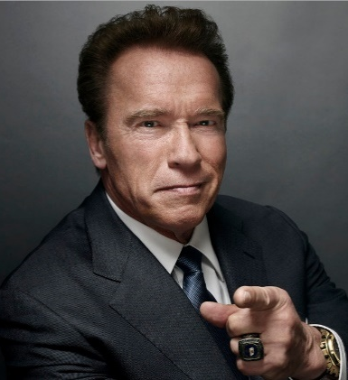
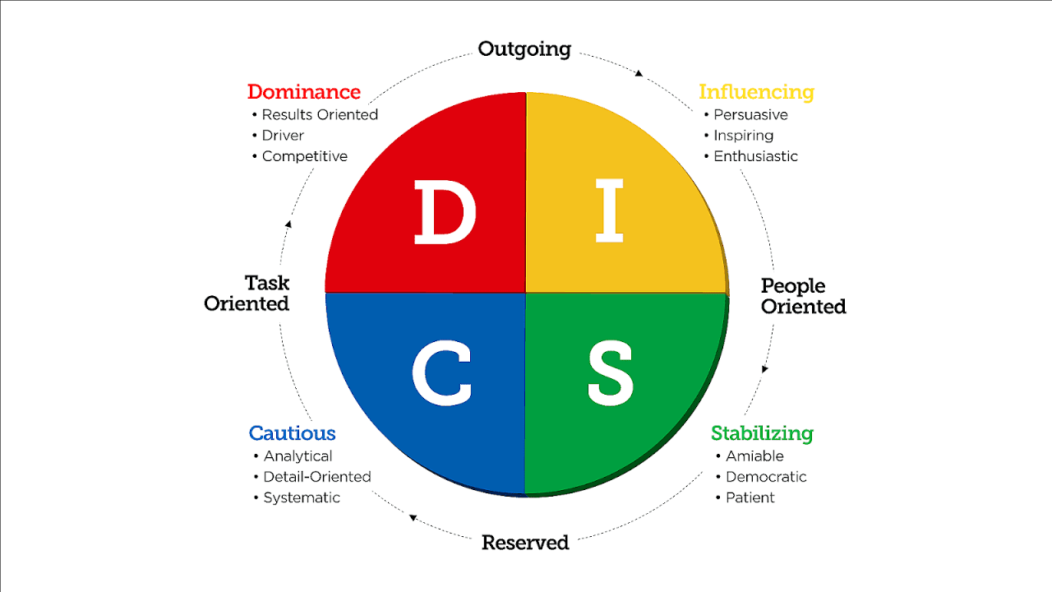
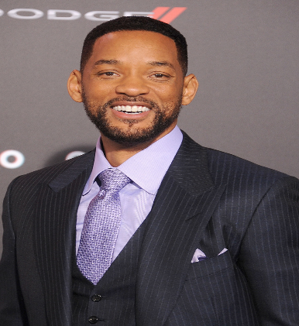
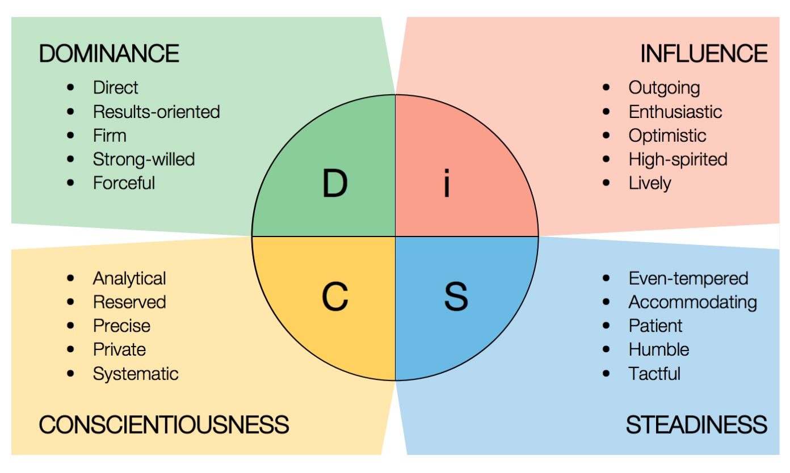
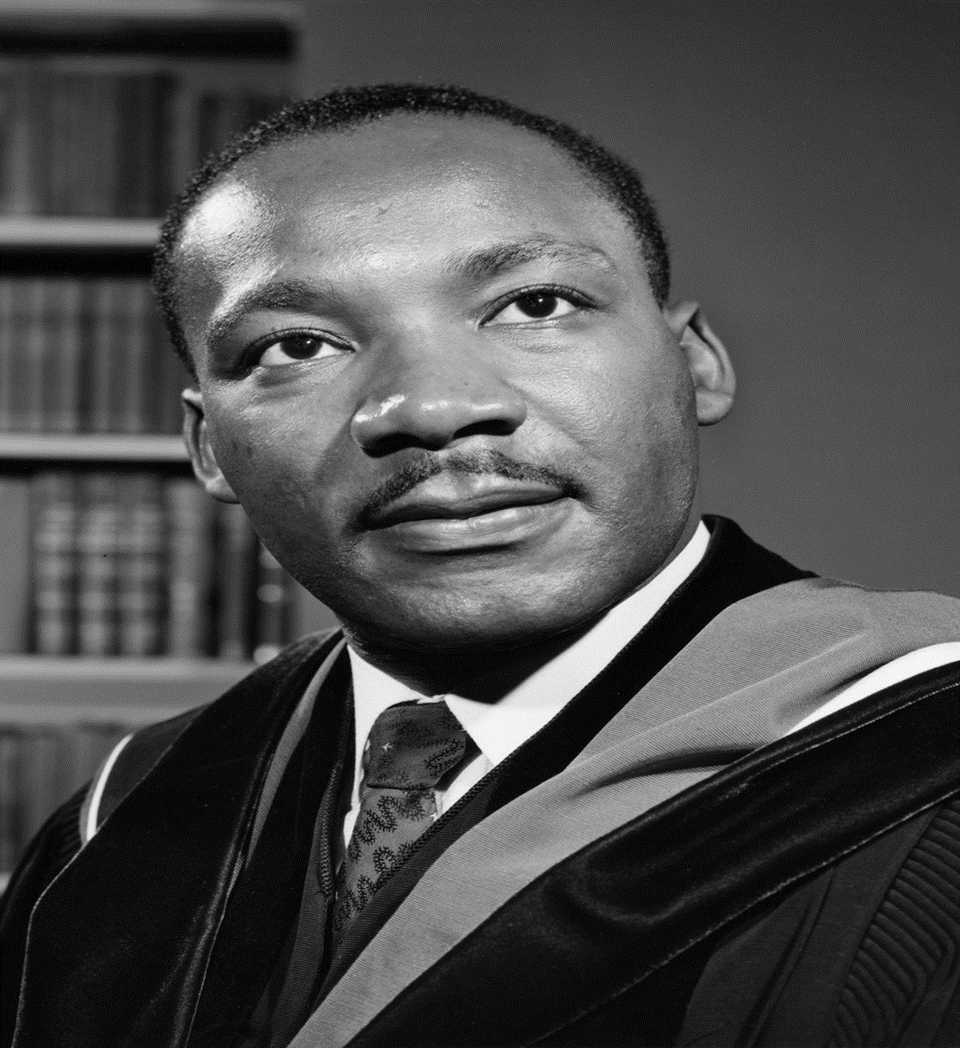
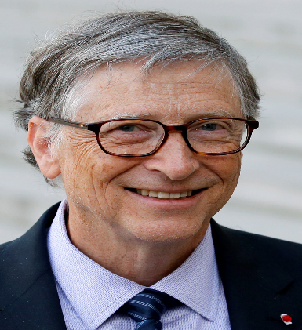
DIFFERENT EMPLOYEES: DISC
Notes:
This slide summarizes the characteristics of the 4 types

Slide 93
ACTIVITY 6 DISC MODEL
How do we deal with these different personality types?
In your breakout groups suggest the best ways to deal with the personality you have been allocated.
Notes:
SAY:
OK, How would you go about dealing with these personalities within your team

Slide 94
DIFFERENT EMPLOYEES: DISC
DOMINANCE: HOW TO WORK WITH
Support their goals and objectives
Keep the relationship business-like
If you disagree, focus on the facts
Be prepared, time-disciplined and well organized
Get right to the point
Focus on their goals and agenda
Show clear solutions, rewards and “bottom-line” results
Don’t compliment them excessively
To motivate, give them enough information and alternatives in order to decide (and they will)
Notes:
Module 2: Make a Connection
“Work With Me” (Dominance)
Key Points:
When Communicating: Stick to business Be brief and to the point Be prepared with a well-organized “package”
Support their goals and objectives
Keep the relationship business-like at the beginning
If you disagree, focus on the facts
Be prepared, time-disciplined and well organized
Get right to the point
Focus on their goals and agenda
Show clear solutions, rewards and “bottom-line” results
Use interactive presentations
Don’t “be overly charming” and compliment them excessively
To motivate, give them enough information and alternatives in order to decide (and they will)
Go To The Next Slide

Slide 95
DIFFERENT EMPLOYEES: DISC
INFLUENCE: HOW TO WORK WITH
Support their opinions, ideas and beliefs
Do not hurry discussions; let them ramble
Never argue with them!
Always summarize (in writing, or they will forget)
Be outgoing and fast-moving; they HATE boring people
Allow them to do most of the talking
Compliment their ideas
Learn their dreams and vision
To motivate, give special deals
Notes:
“Work With Me” (Influence)
Key Points:
When Communicating: Provide a warm, friendly environment Put details in writing Ask “feeling” questions
Support their opinions, ideas and beliefs
Do not hurry discussions; let them ramble
Never argue with them!
Always summarize (in writing, or they will forget)
Be outgoing and fast-moving; they HATE boring people
Allow them to do most of the talking
Compliment their ideas
Learn their dreams and vision
To motivate, give special deals
Go To The Next Slide

Slide 96
DIFFERENT EMPLOYEES: DISC
STEADINESS: HOW TO WORK WITH
Support their feelings; show personal interest
When you disagree, discuss personal feelings
Move the business process in a slow, informal manner; proceed at a good, steady pace
Listen actively and show concern
Provide proof of minimal risk (personal guarantee)
Build a strong relationship and trust
Close without pushing
Notes:
“Work With Me” (Steadiness)
Key Points:
When Communicating: Present your case softly and nonthreateningly Give “time to think” Set expectations up front—no surprises
Support their feelings; show personal interest
When you disagree, discuss personal feelings
Move the sales process in a slow, informal manner; proceed at a good, steady pace
Listen actively and show concern
Provide proof of minimal risk (personal guarantee)
Build a strong relationship
Involve them personally in the presentation
Close without pushing
Focus on relationship and trust
To motivate, show how decisions will personally benefit them
Go To The Next Slide

Slide 97
DIFFERENT EMPLOYEES: DISC
CONSCIENTIOUS: HOW TO WORK WITH
Support their organized approach
Demonstrate through actions vs. words
Be systematic, organized and prepared
Provide advantages and disadvantages
Give them time to verify your words and actions
Provide factual evidence
Greet shortly and make your point quickly
Use logic vs. emotion
To motivate, compliment their logic, organized thinking and efficiency
Notes:
“Work With Me” (Conscientious)
Key Points:
When Communicating: Prepare your case in advance Stick to business Keep emotions to a minimum Be accurate and realistic
Support their organized, thoughtful approach
Demonstrate through actions vs. words
Be systematic, organized and prepared
Provide advantages and disadvantages
Give them time to verify your words and actions
Like a predictable outcome
Provide factual evidence to support your claims
Greet cordially and make your point quickly
Use logic vs. emotion
To motivate, appeal to their accuracy and logic
Compliment their organized thinking and efficiency
Transition:
What happens when you’re an “I” and your customer is a “C”?

Slide 98
DIFFERENT EMPLOYEES: EMPLOYEE TYPES
Types
High Commitment – Low Skill
Beginner
Low Commitment – Some Skill
Disillusioned
Variable Commitment – Moderate Skill Reluctant
High Commitment – High Skills
Peak performer.
04
01
COMMITMENT
03
02
SKILL
Notes:
We have all had people in our teams in aall these positions s

Slide 99
ACTIVITY 7 EMPLOYEE TYPES
How do we deal with these different employee types? Think in terms of…
What they are like as an employee?
Best way to manage them?
Notes:
SAY:
OK, HoThink about the members of your own teams In terms of their personality type and what type of employee they are

Slide 100

DIFFERENT EMPLOYEES: EMPLOYEE TYPES
1
Beginner: High Commitment – Low Skill
New – Unskilled, Optimistic, Curious, Excited, Eager.
Direct them: High Direction, High Supervision.
Define tasks and prioritize work.
Teach – Provide instructions and demonstrate tasks.
Provide frequent feedback
Closely monitor progress
Notes:
Beginners need a lot of attention

Slide 101
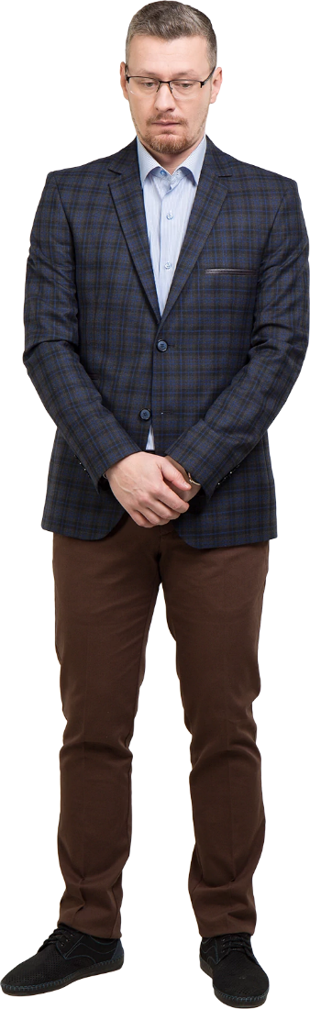
DIFFERENT EMPLOYEES: EMPLOYEE TYPES
2
Disillusioned: Low Commitment – Some Skill
Some level of competence but does not like the reality of the job.
They are Overwhelmed, Confused, Discouraged, Frustrated, but occasionally competent.
Coach them: High Direction – High Support.
Explain and clarify any confusion.
Ask questions that promote learning.
Encourage them, provide developmental feedback
Notes:
Disillusioned will take up a lot time but it may be worth it in the end

Slide 102
DIFFERENT EMPLOYEES: EMPLOYEE TYPES
3
Reluctant: Varied Commitment – Moderate Skill
Mastered most elements of the job, but lacks confidence.
Direct them: Low direction – High support.
Ask & Listen: Develop independent problem solving.
Reassure them that they are going in the right direction.
Express your appreciation for their efforts.
Collaborate with them on difficult tasks.
Notes:
Again these people can be an asset in the long term

Slide 103
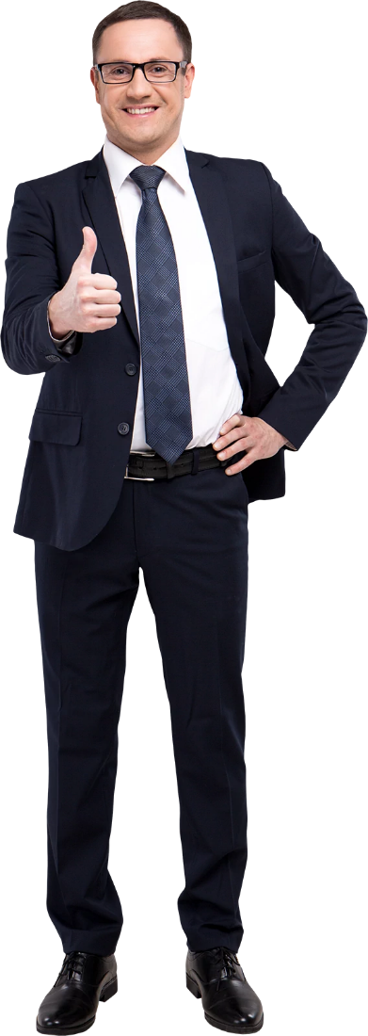
DIFFERENT EMPLOYEES: EMPLOYEE TYPES
4
Peak Performer: High Commitment – High Skill
Very experienced – Mastered all elements of job, fully engaged and independently motivated.
Confident, Consistent Performer, Autonomous, Accomplished, Inspiring, seen as an expert within the team.
Delegate: Low direction – Low support.
Empower and confirm.
Provide challenging tasks to keep them motivated.
Acknowledge results. Ensure they know their worth.
Notes:
You could well be looking at your successor here.

Slide 104
MODULE FIVE
COACHING & MENTORING

Slide 105
COACHING & MENTORING
Coaching & Mentoring defined
01
Coaching
02
Mentoring
03
People Development
04

Slide 106
ACTIVITY 8 COACHING & MENTORING
Define what coaching and mentoring are.
Indicate where they differ.
Notes:
SAY:
What is the difference between coaching and mentoring

Slide 107

COACHING & MENTORING
Mentoring
A mentor is someone who shares their wisdom and can facilitate action that has a positive effect on our careers and lives.
Mentorship often evolves from a previous relationship and can also be formed with a current boss.
Mentoring is often done informally and is unpaid.
There is very rarely a set agenda.
Contacts range from very frequent to an as needed basis.
Notes:
A mentor is someone who shares their wisdom and can facilitate action that has a positive effect on our careers and lives.
Mentorship often evolves from a previous relationship and can also be formed with a current boss.
Mentoring is often done informally and is unpaid.
There is very rarely a set agenda.
Contacts range from very frequent to an as needed basis

Slide 108

COACHING & MENTORING
Mentoring
Freddie Laker
Aristotle
Sir Lawrence Olivier
Johann C. Bach
Roger Corman
Alexander the Great
Sir Richard Branson
Sir Anthony Hopkins
James Cameron
Wolfgang Amadeus Mozart
Notes:
OK try and identify the mentor and the protégé

Slide 109
COACHING & MENTORING
Mentoring
Freddie Laker
Aristotle
Sir Lawrence Olivier
Johann C. Bach
Roger Corman
Sir Richard Branson
Alexander the Great
Sir Anthony Hopkins
Wolfgang Amadeus Mozart
James Cameron

Slide 110

COACHING & MENTORING
Coaching
A conversation containing advice that helps people develop their skills, achieve success and reach their goals.
Expressing the truth, confronting tough issues.
Uses language that will inspire.
Usually one on one, but not always, Sports Teams for example.
It is NOT a performance management tool.
It should NOT be part of disciplinary discussions.
Notes:
Coaching
A conversation containing advice that helps people develop their skills, achieve success and reach their goals.
Expressing the truth, confronting tough issues.
Uses language that will inspire.
Usually one on one, but not always, Sports Teams for example.
It is NOT a performance management tool.
It should NOT be part of disciplinary discussions.

Slide 111
COACHING & MENTORING
Coaching
Coaching has evolved to become an expected competency for Supervisors and Managers.
Coaching should not be confused with career counseling or performance reviews.
It is the day to day, hands on process of helping employees recognize opportunities to improve their performance and abilities.
Notes:
Coaching has evolved to become an expected competency for Supervisors and Managers.
Coaching should not be confused with career counseling or performance reviews.
It is the day to day, hands on process of helping employees recognize opportunities to improve their performance and abilities.

Slide 112
COACHING & MENTORING
Coaching – Critical Skills
Communication Skills.
Helping Skills.
Mentoring Skills.
Teaching Skills.
Challenging Skills.
Notes:
SAY There are 5 skills that every effective coach needs. They are

Slide 113
ACTIVITY 9 COACHING ASSESSMENT
Rate yourself from 1 to 5 for the following statements.
Where 5 is very characteristic of your behavior and 1 is very uncharacteristic of your behavior.
Notes:
SAY:
OK everyone let's spend a few minutes and I want you to come up with a list of what a leader is, what their role is, and how a leader is different from a Manager

Slide 114
COACHING & MENTORING
Coaching – Coaching Assessment
I make contact with employees and talk to them as individuals on a daily basis.
I am approachable. Employees are comfortable approaching me with issues.
I know my employees as individuals. They feel that I care about them.
I am a good listener. I pay attention when others speak to me.
Conversations are two-way, both parties can exchange views.
Notes:
Gauge your self from 1 to 5 for each of these

Slide 115
COACHING & MENTORING
Coaching – Coaching Assessment
I try to identify the real problem rather than try to fix the symptoms.
I encourage employees to find their own solutions to problems.
I encourage creativity and innovation.
I am open to new ways of doing things.
I ask employees to take responsibility for their own problems.
Notes:
Gauge your self from 1 to 5 for each of these

Slide 116
COACHING & MENTORING
Coaching – Coaching Assessment
Employees feel safe telling me when they have made mistakes.
Employees are never made to feel inferior because of mistakes.
Employees are encouraged to develop new skills or knowledge.
Employees feel I am patient when they are learning a new skill.
I recognize strengths and encourage employees to work with their strengths.
Notes:
Gauge your self from 1 to 5 for each of these

Slide 117
COACHING & MENTORING
Coaching – Coaching Assessment
I suggest networking opportunities to employees.
Employees consider me a resource for suitable career options.
I encourage employees to apply for positions that they are suited for.
I give employees advice managing their way in the business.
Employees consider me a resource for administrative matters.
Notes:
Gauge your self from 1 to 5 for each of these

Slide 118
COACHING & MENTORING
Coaching – Coaching Assessment
I help employees confront excuses.
I hold employees responsible for their own development.
I give feedback on my observations without being judgmental.
I help employees recognize unproductive behaviors.
I am future-focused rather than past-oriented.
Notes:
Gauge your self from 1 to 5 for each of these

Slide 119
COACHING & MENTORING
Coaching – Coaching Assessment
1 -5 Communication Skills
6-10 Helping Skills
11-15 Teaching Skills
16-20 Mentoring Skills
21-25 Challenging Skills
Add up your scores
Notes:
Just so you know the questions were divided up into the 5 areas

Slide 120
COACHING & MENTORING
Coaching – Coaching Assessment
100 -125
Your coaching can build real momentum
60-99
You are creating good momentum
45-59
You have a good start
Below 40
Work on elements of communication
Notes:
Depending on your score these are where you are in terms of being a great coach for your team

Slide 121
COACHING & MENTORING
Coaching – Critical Skills
Communication Skills.
Helping Skills.
Mentoring Skills.
Teaching Skills.
Challenging Skills.
Notes:
Let’s remind ourselves of what the skills were

Slide 122
COACHING & MENTORING
Coaching – Communication Skills
Communication Skills are a pathway by which interactions are made clear.
One-way communications are not part of coaching, neither is giving orders.
Notes:
SAY Communication is crucial in coaching

Slide 123
COACHING & MENTORING
Communication Skills
TONE OF VOICE
FACIAL EXPRESSIONS
THE WORDS WE USE
OTHER BODY LANGUAGE
COMMUNICATION
Notes:
Not just what we say, but how we say it and what our bodies are doing while we say it

Slide 124
COACHING & MENTORING
Communication Skills – Words we use
Helpful
We
Please & Thank you
Simple words
Easily understood words
Hurtful
Jargon
Absolutes “Must” “Never”
Negatives
Vulgar words
“But”
“However”
Notes:
Words are very powerful in coaching

Slide 125
COACHING & MENTORING
Communication Skills – Tone of voice
Helpful
Interested
Patient
Friendly
Variation in pitch
Audible
Clear
Hurtful
Monotone
Too fast or slow
Too indecisive or abrupt
Too hurried or mumbled
Condescending
Impatient
Notes:
Make sure we are using the appropriate tone

Slide 126
COACHING & MENTORING
Communication Skills – Facial Expressions
Helpful
Eye contact
Relaxed
Friendly
Alert
Hurtful
Frowning, tense, angry
Bored, disinterested
Rolling your eyes
Yawning
Looking at watch
No eye contact

Slide 127
COACHING & MENTORING
Communication Skills – Body Language
Helpful
Attentive
Leaning towards the person
Open body movements
Not interrupting
Hurtful
Looking at watch
Doing other things while person is talking
Arms crossed
Shrugging shoulders
Hands on hips

Slide 128
COACHING & MENTORING
Helping Skills
Give your employees problem solving tools.
Ask them to identify possible solutions, make recommendations.
Ask them good open, probing questions to make them think.
Stay open-minded to alternatives
Notes:
Helping skills need to be seen if you are looking to successfully coach your employee

Slide 129
COACHING & MENTORING
Mentoring Skills
Find ways of introducing your employees to other individuals and departments in your business.
Arrange for them to sit in meetings that may be beneficial to them in the future.
Help them find other mentors in other areas.
Discuss the future and their aspirations.
Keep your eyes open to positions that they may be, both interested in and suitable for.
Notes:
Mentoring is a huge part of coaching

Slide 130
COACHING & MENTORING
Teaching Skills
Look at training opportunities that will be beneficial for their future.
Use mistakes as learning opportunities.
Encourage them to use their new skills at every opportunity.
Stay open-minded to alternatives
Notes:
All coaches are teachers at heart

Slide 131
COACHING & MENTORING
Challenging Skills
Remember, your role as a coach is to help your employee reach their potential.
Be clear in your own mind what you expect of your employee.
Spend time with employees so you are fully aware of their progress.
Help them set SMART goals.
Help them create plans to achieve the goals.
Notes:
Challenging coaching situations are challenging for both you and the coached

Slide 132
COACHING & MENTORING
VAK Learning styles
Not all people learn in the same way
V Visual
A Auditory
K Kinesthetic

Slide 133
ACTIVITY 10 LEARNING STYLES
Explain how you would coach someone regarding their poor performance regarding Vehicle Presentation using the V, A & K methods.
Notes:
SAY:
OK everyone let's spend a few minutes and I want you to come up with a list of what a leader is, what their role is, and how a leader is different from a Manager

Slide 134
COACHING & MENTORING
Coaching Tips
Use questions to get employees to think and to promote discussion.
Set progress targets and get agreement from the employee.
Confirm the employees understanding.
Give praise when deserved.
Reinforce good points that will accelerate the learning.
Clarify the next step.
Make it clear that you are looking forward to the next steps of development.
Notes:
SAY Lets look at some tips to help you as a coach

Slide 135
COACHING & MENTORING
Coaching Tips - Feedback
Feedback should always be given in private.
It should be balanced, use the sandwich method: Good, Poor, Good feedback.
Don’t get distracted by other matters the feedback should only be relevant to the matter at hand.
Document all the feedback sessions.
Deliver it in a suitable method taking into account the DISC personality of your employee.
Notes:
Feedback is one of the most important stages of coaching

Slide 136
COACHING & MENTORING
Succession Planning
The process of identifying people who could presently move into key positions or could do so after specifically targeted development occurs.
Whatever your position is currently, a key position is anyone that directly affects you.
Succession planning is not just for senior executives…..
Notes:
Succession planning The head of GE was identified 17 years prior to getting the job as a potential senior manager

Slide 137
COACHING & MENTORING
Succession Planning
Three types of succession planning:
Role Based – Focuses on key positions that are difficult to fill and are critical to business success.
Individual Based – Focuses on employees with the potential for advancement.
Pool Based – Focuses on a number of high potential individuals who could move into several positions within the business.
Which method are you using to identify your successor?

Slide 138
MODULE SIX
PROBLEM SOLVING
Notes:
In this module we will look at problem solving decision making and conflict resolution

Slide 139
PROBLEM SOLVING
Problem Solving
01
Decision Making
02
Conflict Resolution
03

Slide 140

PROBLEM SOLVING
No leader can possibly have all the answers.
“The actual solution to the challenges faced by modern business can only truly be solved by the people closest to the action.”
Steve Miller – Royal Dutch / Shell
Great leaders make use of the resources in their teams to overcome obstacles.

Slide 141
ACTIVITY 11 PROBLEM SOLVING
How do you solve the problems that occur on a daily basis?
Notes:
SAY:
OK everyone let’s think about some of the problems we have experienced and how we solved them.

Slide 142
PROBLEM SOLVING
The 4 Questions
What is the problem?
What is the cause of the problem?
What are the possible solutions to the problem?
What is the best solution to the problem?
Notes:
In order to solve any problem we need to answer these 4 questions

Slide 143
PROBLEM SOLVING: FISH BONE METHOD
Product
People
Process
Problem
Equipment
Environment
Management
Notes:
SAY: Has anyone used the fish bone method of problem solving Sometime called the KAWASAKI METHOD

Slide 144
ACTIVITY 12: PART 1 FISH BONE METHOD
Poor Customer Satisfaction.
What are possible causes?
Notes:
SAY:
OK, First thing we need to do is identify the cause, they may be many

Slide 145
PROBLEM SOLVING: FISH BONE METHOD
Staff under paid
Staff untrained
No standard system
No measurement
Low staff morale
Management support
Delivery times
Reliability issues
Not enough phones
Staff turnover
Unappreciated staff
Demo numbers
Parking
Product
People
Process
Poor Customer Satisfaction
Equipment
Environment
Management
Notes:
SO here is a list of some possible causes

Slide 146
ACTIVITY 12: PART 2 FISH BONE METHOD
Allocated the issues into the 6 categories.
Notes:
SAY:
OK, Take these issues are categorize them in the fishbone

Slide 147
PROBLEM SOLVING: FISH BONE METHOD
Staff under paid
Staff untrained
No standard system
No measurement
Low staff morale
Management support
Delivery times
Reliability issues
Not enough phones
Staff turnover
Unappreciated staff
Demo numbers
Parking
Product
People
Process
Poor Customer Satisfaction
Equipment
Environment
Management
Notes:
SAY:
OK, Take these issues are categorize them in the fishbone

Slide 148
PROBLEM SOLVING: FISH BONE METHOD
Staff under paid
Staff untrained
No standard system
No measurement
Low staff morale
Management support
Delivery times
Reliability issues
Not enough phones
Staff turnover
Unappreciated staff
Demo numbers
Parking
Product
People
Process
Delivery times
Staff under paid
No standard system
Reliability issues
Staff untrained
No measurement
Management support
Delivery times
Poor Customer Satisfaction
No of phones
Low staff morale
Low staff morale
Demo numbers
Parking
Management support
Unappreciated staff
Equipment
Environment
Management
Notes:
Lets look at where they should go

Slide 149
PROBLEM SOLVING: FISH BONE METHOD
Staff under paid
Staff untrained
No standard system
No measurement
Low staff morale
Management support
Delivery times
Reliability issues
Not enough phones
Staff turnover
Unappreciated staff
Demo numbers
Parking
Multiple Locations
Product
People
Process
Delivery times
Staff under paid
No standard system
Reliability issues
Staff untrained
No measurement
Management support
Delivery times
Poor Customer Satisfaction
No of phones
Low staff morale
Low staff morale
Demo numbers
Parking
Management support
Unappreciated staff
Equipment
Environment
Management
Notes:
Lets look at where they should go

Slide 150
PROBLEM SOLVING: FISH BONE METHOD
The 4 Questions
What is the problem?
What is the cause of the problem?
What are the possible solutions to the problem?
What is the best solution to the problem?
Notes:
Costs What we have done here is take care of the first 2 questions

Slide 151
ACTIVITY 12: PART 3 FISH BONE METHOD
How can we resolve the zero / low cost issues.
Notes:
SAY:
SO how can we resolve the zero / low costs problems

Slide 152
PROBLEM SOLVING: FISH BONE METHOD
Staff under paid
Staff untrained
No standard system
No measurement
Low staff morale
Management support
Delivery times
Reliability issues
Not enough phones
Staff turnover
Unappreciated staff
Demo numbers
Parking
Zero / Low Cost
Product
People
Process
Delivery times
Staff under paid
No standard system
Reliability issues
Staff untrained
No measurement
Management support
Delivery times
Poor Customer Satisfaction
No of phones
Low staff morale
Low staff morale
Demo numbers
Parking
Management support
Unappreciated staff
Equipment
Environment
Management
Notes:
Lets look at where they should go

Slide 153
DECISION MAKING
One of the greatest issues regarding decision making is… TIME.
It is one of our most valuable commodities.
We never have enough of it.
We have to prioritize in order to use our time as efficiently as possible.
Notes:
SAY: Problems are often because of a lack of time

Slide 154
ACTIVITY 13 PART 1 EISENHOWER
Create a list of your daily tasks
Notes:
SAY:
We talked about the Eisenhower method earlier, Let’s now use it in our daily life
First off write down a list of some of your daily tasks

Slide 155
DECISION MAKING
Daily Tasks
Team meetings.
Second Facing / Customer interaction
Management meetings.
Stock consolidation.
Forecast reports.
Financials

Slide 156
ACTIVITY 13 PART 2 EISENHOWER
Now let’s use the Eisenhower method of prioritization.
Notes:
SAY:
Now let’s use the Eisenhower method

Slide 157
DECISION MAKING
Eisenhower's method of prioritization
URGENT
NOT URGENT
Team meetings.
Second Facing / Customer interaction
Management meetings.
Stock consolidation.
Forecast reports.
Financials
IMPORTANT
NOT IMPORTANT
Notes:
Where should they go

Slide 158
DECISION MAKING
Eisenhower's method of prioritization
URGENT
NOT URGENT
Team meetings.
Second Facing / Customer interaction
Management meetings.
Stock consolidation.
Forecast reports.
Financials
IMPORTANT
PERSONAL
DELEGATION
NOT IMPORTANT
DELEGATION
TRAINING
Notes:
Where should they go

Slide 159
CONFLICT RESLOUTION
Situational awareness of the following
Potential conflict. Situations exist that could lead to conflict.
Unexpressed conflict. There are clues that differences exist, and tension is building.
Indirectly expressed. People talk about their position to third parties.
Directly expressed. People express their differences to each other.
Polarized. People are 100% committed to a particular position.
Notes:
Conflict resolution
You always need to be aware of the dynamics within your team

Slide 160
CONFLICT RESLOUTION
Escalation of Conflict
Full Scale Escalation
Limited Destructive Blows
Strategies of Threat
Loss of Face – View others as immoral
Perpetuate Stereotypes and Divisions
Title
Impede through Actions
Open Verbal Confrontation
Hardening of Position
Notes:
There is a very clear path that all conflicts cover as they escalate

Slide 161
CONFLICT RESLOUTION
Your Position in Conflict
In many cases you will be the divider between the conflicting sides.
You will be required to moderate between the parties.
Knowing how to handle conflict, even when you are not personally involved is a great asset for a leader.
Notes:
Remember in most cases you may have to be the middleman in conflicts as well as being part of it

Slide 162
ACTIVITY 14 CONFLICT RESOLUTION
How do you deal with conflict in your teams?
Notes:
SAY:
OK, I’m sure we have all had conflict in our teams, how do you deal with them

Slide 163
CONFLICT RESLOUTION
Thomas Kilmann Conflict Styles
COMPETE
COLLABORATE
ASSERTIVENESS
COMPROMISE
AVOIDE
ACCOMODATE
COOPERATIVENESS
Notes:
Let’s have a look at the Thomas Kilmann conflict styles

Slide 164
CONFLICT RESLOUTION
Thomas Kilmann Conflict Styles
AVOIDE - SIGNS
COMPETE
COLLABORATE
Unassertive and uncooperative.
The Individual does not pursue their own concerns of those of the other person.
They do not address the conflict.
Sidestep, postpone or simply withdraw from the conflict.
ASSERTIVENESS
COMPROMISE
AVOIDE
ACCOMODATE
COOPERATIVENESS
Notes:
Let’s look at the signs of Avoiding

Slide 165
CONFLICT RESLOUTION
Thomas Kilmann Conflict Styles
AVOIDE - WHEN
COMPETE
COLLABORATE
When an issue is trivial.
When you have no chance of winning.
When damage is greater than the benefit.
When you need more information.
When others can resolve the conflict.
When tension needs to be reduced.
ASSERTIVENESS
COMPROMISE
AVOIDE
ACCOMODATE
COOPERATIVENESS
Notes:
Lets look at WHEN we should Avoide

Slide 166
CONFLICT RESLOUTION
Thomas Kilmann Conflict Styles
ACCOMODATE - SIGNS
COMPETE
COLLABORATE
Unassertive and cooperative.
The Individual neglects their own concerns to satisfy the other individual..
May be a form of selfless generosity.
May be obeying an order even when they prefer not to.
May be yielding to another’s point of view.
ASSERTIVENESS
COMPROMISE
AVOIDE
ACCOMODATE
COOPERATIVENESS
Notes:
Let’s look at the signs of Accommodating

Slide 167
CONFLICT RESLOUTION
Thomas Kilmann Conflict Styles
ACCOMODATE - WHEN
COMPETE
COLLABORATE
When you realize you are wrong.
When the issue is more important to one party than another.
When you need a future favor.
When continuing will cause damage.
When subordinates need to develop.
ASSERTIVENESS
COMPROMISE
AVOIDE
ACCOMODATE
COOPERATIVENESS
Notes:
Let’s look at when we should ACCOMMODATE

Slide 168
CONFLICT RESLOUTION
Thomas Kilmann Conflict Styles
COMPETE - SIGNS
COMPETE
COLLABORATE
Assertive and uncooperative.
The Individual pursues their own concerns at the expense of others.
Will adopt a “win at all costs” attitude.
May be because they are standing up for their rights, they are defending apposition, or they simply want to win.
ASSERTIVENESS
COMPROMISE
AVOIDE
ACCOMODATE
COOPERATIVENESS
Notes:
Let s look at the signs of competing

Slide 169
CONFLICT RESLOUTION
Thomas Kilmann Conflict Styles
COMPETE - WHEN
COMPETE
COLLABORATE
When quick decisive action is required.
On important issues where an unpleasant course of action is required.
On issues of vital importance to the group welfare and you are right.
When you need more information.
When protection is required against people who take advantage of others.
ASSERTIVENESS
COMPROMISE
AVOIDE
ACCOMODATE
COOPERATIVENESS
Notes:
Let’s look at when we should compete

Slide 170
CONFLICT RESLOUTION
Thomas Kilmann Conflict Styles
COLLABORATE - WHEN
COMPETE
COLLABORATE
When both side are too important to compromise.
When it is necessary to test possible outcomes .
When there is a need to combine ideas from other people.
When commitment can be achieved by involving everyone.
When there is a history of bad feeling.
ASSERTIVENESS
COMPROMISE
AVOIDE
ACCOMODATE
COOPERATIVENESS
Notes:
When we should collaborate

Slide 171
CONFLICT RESLOUTION
Thomas Kilmann Conflict Styles
COLLABORATE - SIGNS
COMPETE
COLLABORATE
Assertive and cooperative.
Will work with other parties to find a solution that is satisfactory for all.
Identify the concerns of all parties and searching for alternatives.
Explore a disagreement to understand each party's viewpoint.
Generating creative solutions.
ASSERTIVENESS
COMPROMISE
AVOIDE
ACCOMODATE
COOPERATIVENESS
Notes:
Let’s look at the signs of collaboration

Slide 172
CONFLICT RESLOUTION
Thomas Kilmann Conflict Styles
COMPROMISE - SIGNS
COMPETE
COLLABORATE
Intermediate of both assertive and cooperative.
Objective is to find a mutually acceptable solution.
Middle ground between competing and accommodating, avoiding and collaborating.
Might mean splitting the difference, making concessions or seeking a quick middle ground position.
ASSERTIVENESS
COMPROMISE
AVOIDE
ACCOMODATE
COOPERATIVENESS
Notes:
The signs of compromise

Slide 173
CONFLICT RESLOUTION
Thomas Kilmann Conflict Styles
COMPROMISE - WHEN
COMPETE
COLLABORATE
When Goals are important but not worth the disruption.
When two parties of equal strength are equally committed to exclusive goals.
When temporary settlements are needed because of complex issues.
When quick solutions are needed because of time constraints.
As back up for when competing & collaborating fails.
ASSERTIVENESS
COMPROMISE
AVOIDE
ACCOMODATE
COOPERATIVENESS
Notes:
When we should compromise

Slide 174
CONFLICT RESOLUTION
Key Points
You must develop the skills to use all 5 of the modes and educate others in their use.
Do not become associated with just one of the modes.
Do not have a favorite mode or fall into the trap of using just one.
Conflict is often a result of personal predispositions and situational requirements. Ensure you take both into consideration.
Notes:
Let’s examine some of the key points

Slide 175
MODULE SEVEN
BOSS TO LEADER

Slide 176
BOSS TO LEADER
Bad v Good
01
Leadership traits
02
Key tips
03

Slide 177
ACTIVITY 15 BAD v GOOD
Take a few minutes and note some of the traits of bad & good bosses?
Notes:
SAY:
OK, List some of the habits of good and bad bosses

Slide 178
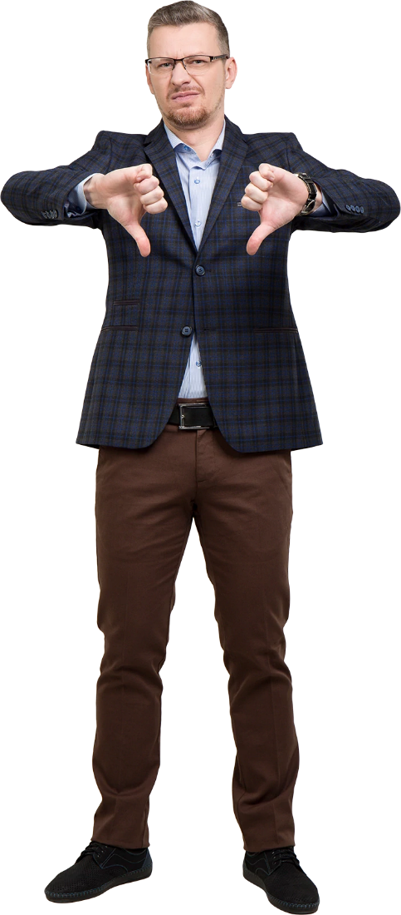
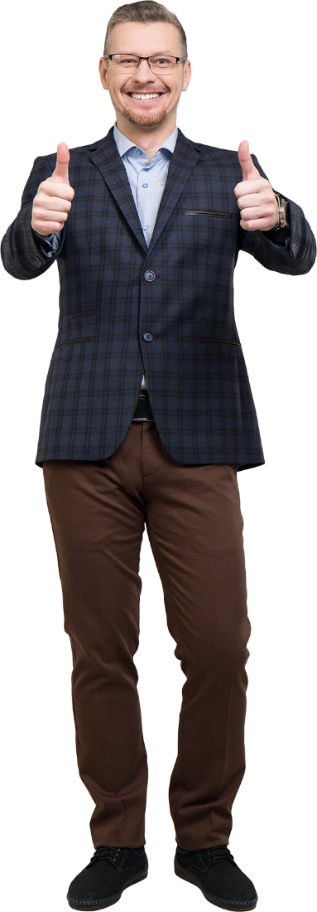
BOSS TO LEADER
BAD V GOOD
Unreachable
Micromanage
Shirk Responsibility
Waste other peoples time
Disrespectful
Do not provide feedback
Have favorites
Encourage toxic situations
Breed negativity
Keep people from growing
Intimidating reputation
Take things personally
Always available
Trust staff to do their jobs
Take charge
Value other peoples time
Respectful
Provide feedback
Treat employees fairly
Deal quickly with situations
Foster positivity
Help people to grow
Cultivate a team attitude
Don’t hold a grudge
Notes:
Here are some of the signs of each

Slide 179
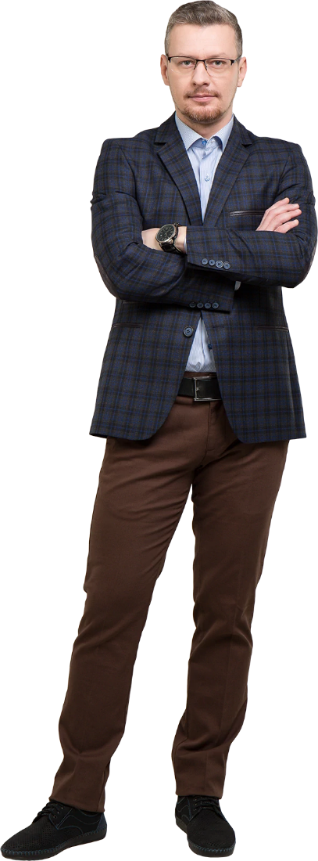
BOSS TO LEADER
Boss
A boss is someone who holds a management position and directs others.
It does not automatically make them into a leader, but they can develop into one.
It’s not just about giving orders – a boss can be a leader too.
Becoming a better boss means developing into a leader.
Notes:
Let’s remind ourselves What is a boss

Slide 180
BOSS TO LEADER
Leader
A leader creates an environment where everyone is working as a team.
A leader will pitch into help fix problems that may arise.
A leader believes that success comes from everyone reaching their potential.
A leader cares about the people that work for him.
Notes:
Let’s remind ourselves What is a leader

Slide 181
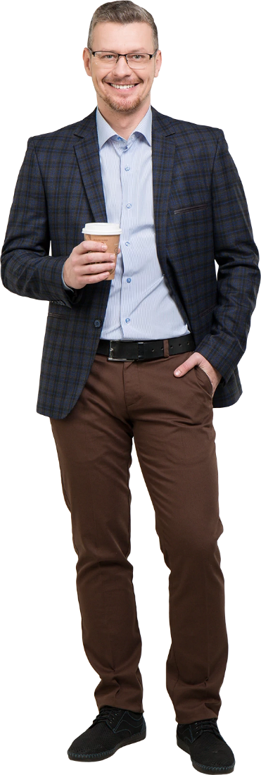
BOSS TO LEADER
Admirable Traits
Behavior Traits
Willing to help colleagues
Show care and concern
Lead by example
Respect people and their opinions
Create a supportive atmosphere
Seeks the opinion of others
Ensure a pleasant environment
Address toxic situations
Pitches in to help on projects
Help people grow
Encourages staff development
No favorites
Sets SMART goals
Leads doesn’t dictate
Responsible
Accountable
Decisive
Humble
Praise publicly
Criticize privately
Foster positivity
Help people to grow
Cultivate a team attitude
Don’t hold a grudge
Notes:
The traits of a leader are many : No one said being a great leader was easy

Slide 182
BOSS TO LEADER
Common Sense
Successfully leading a group means getting the best out of them every day.
A good leader will use common sense when dealing.
A great leader will install the same common-sense approach in his team.
Notes:
Remember to use common sesnse where you can

Slide 183
BOSS TO LEADER
Common Sense
Treat me right.
Be clear with your communication.
Be an upstanding person.

Slide 184

BOSS TO LEADER
Key Points
Empower, motivate and coach.
Develop yourself through continuous learning.
Delegate wisely.
Be organized.
Resolve conflict
Be efficient and effective
Demand Excellence
Notes:
Finally let’s look at some of the key points to adopt to develop your leadership skills

